Slide 1
Customer Satisfaction Rating “Prediction”

Slide 2
Overview This project develops a machine learning model to predict customer satisfaction in airlines using advanced techniques like CatBoost and Optuna for hyperparameter optimization.
Created by: Md. Rafiquzzaman Rafi
Data Preprocessing
Exploratory Data Analysis
Feature Engineering
Model Training
Key Insights

Slide 3
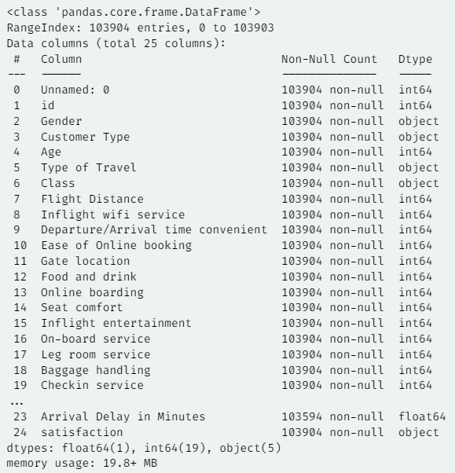
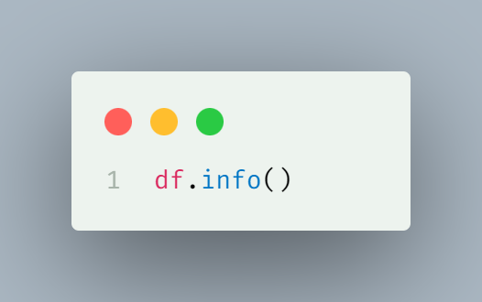
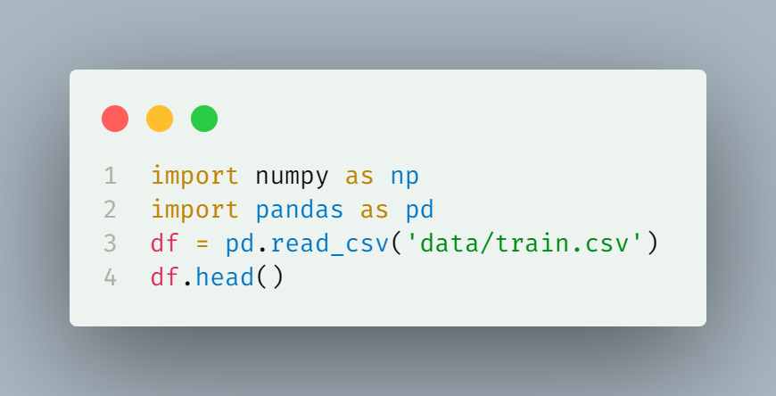
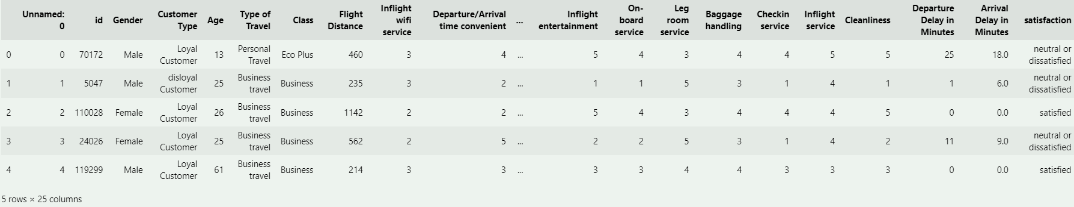
Data Import and Basic Analysis

Slide 4
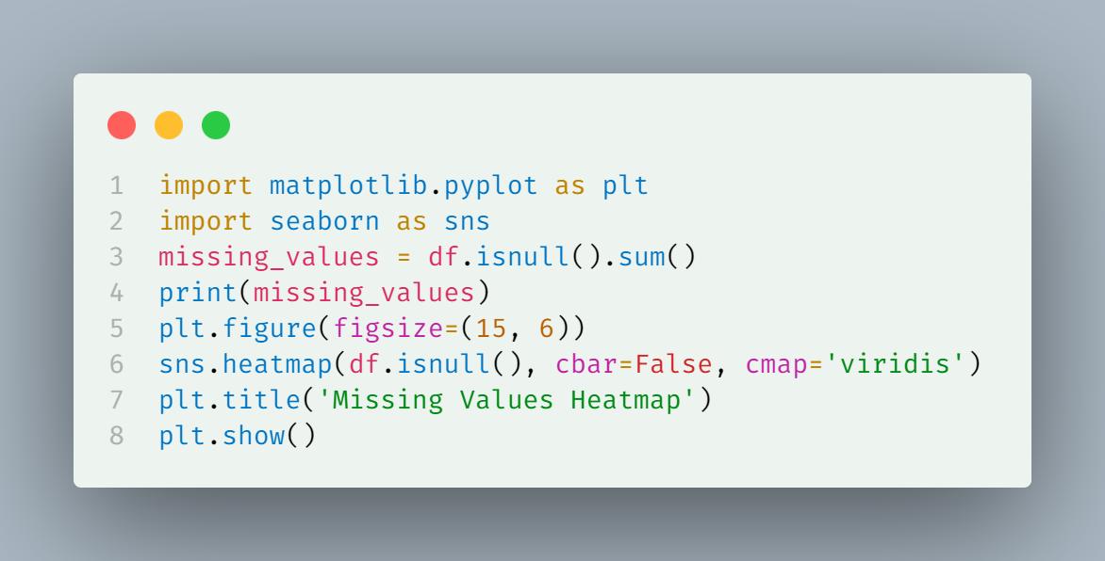
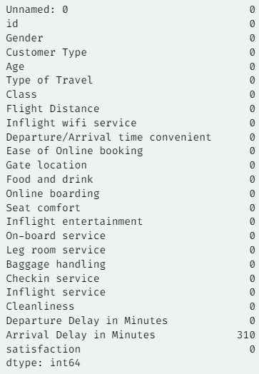
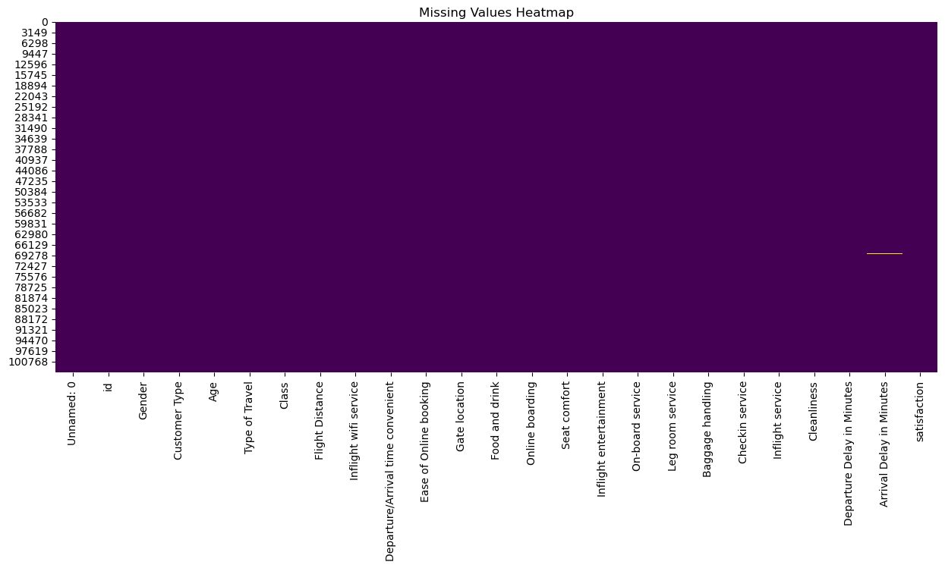
Data Preprocessing

Slide 5
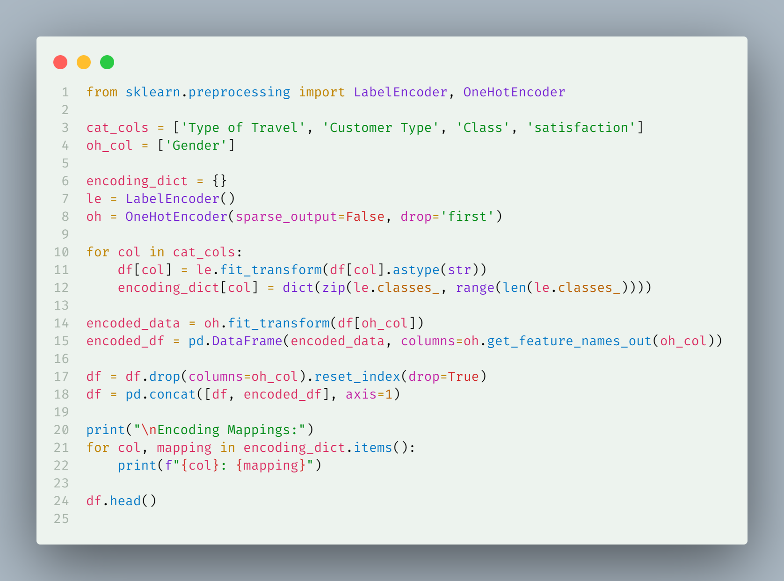
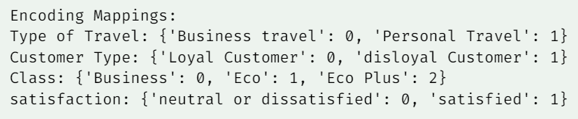
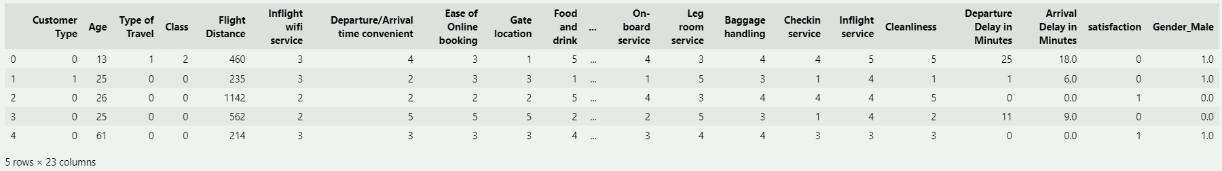
Data Preprocessing

Slide 6
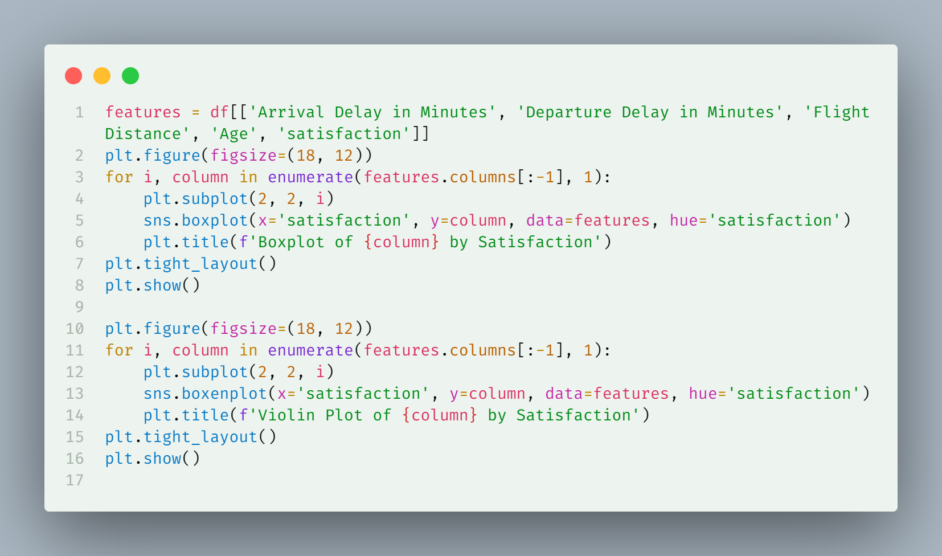
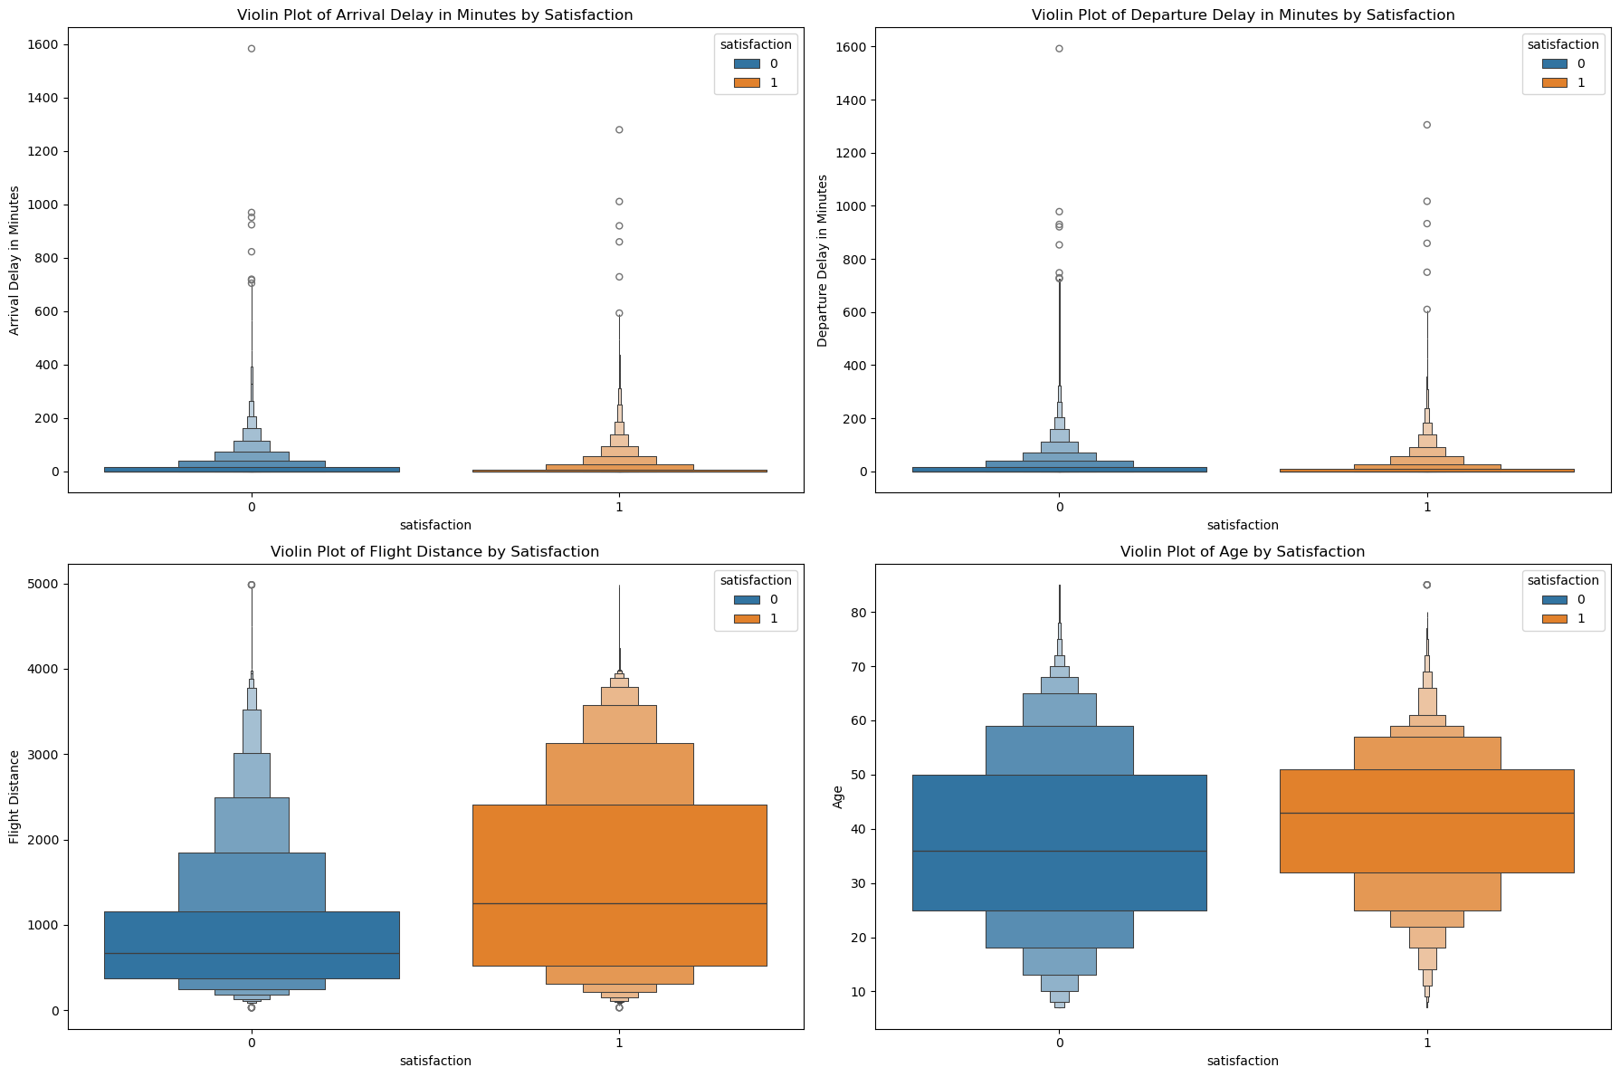
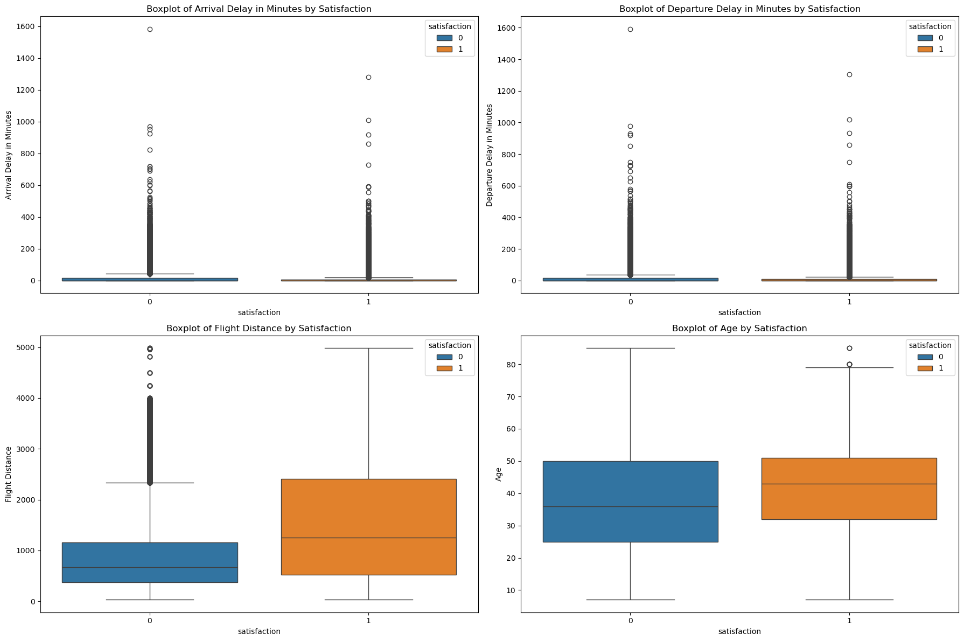
Exploratory Data Analysis

Slide 7
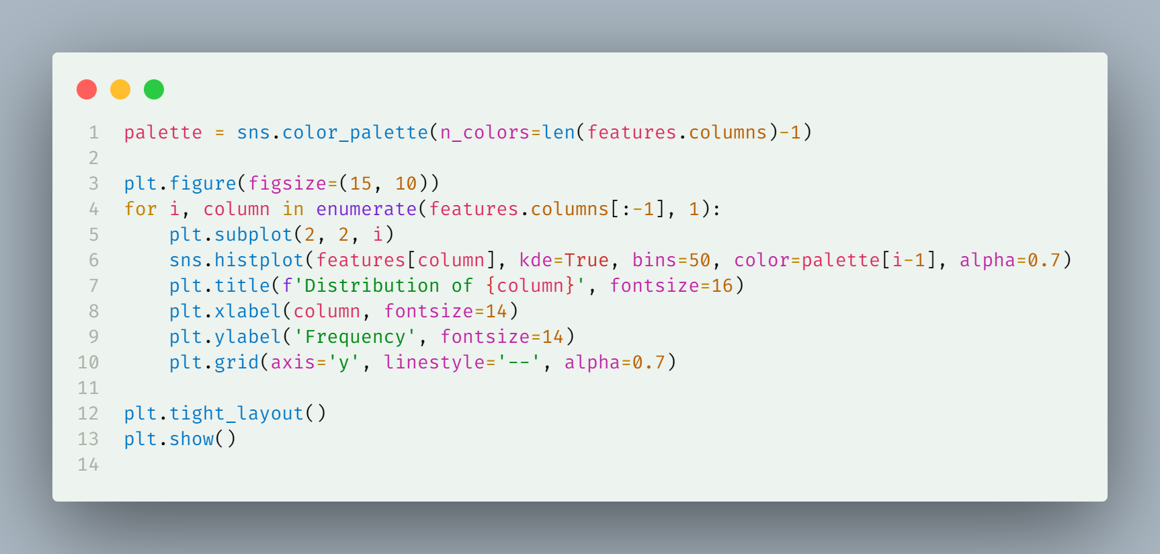
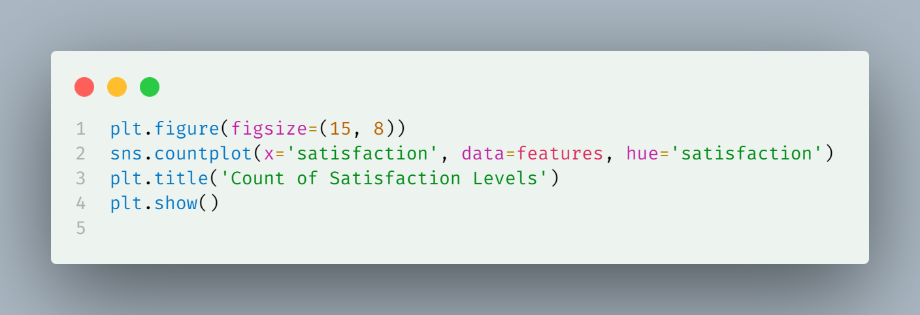
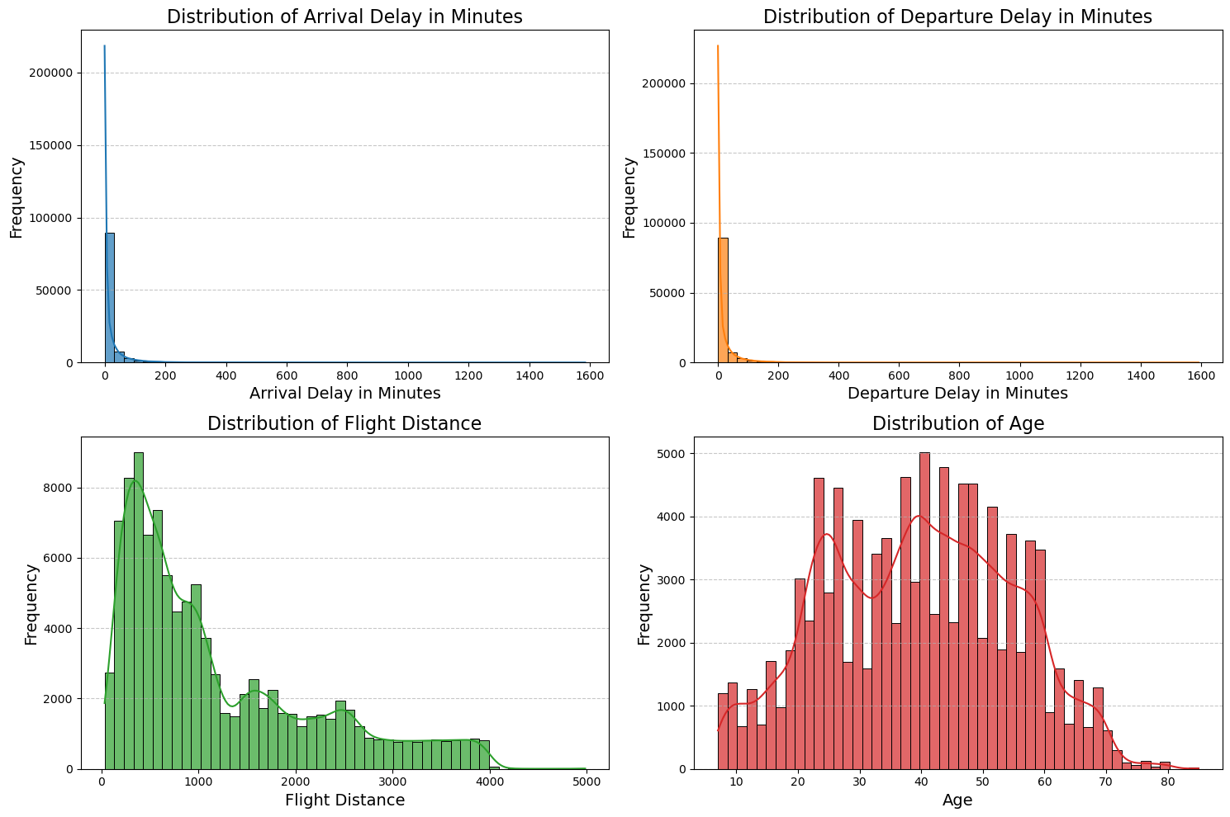
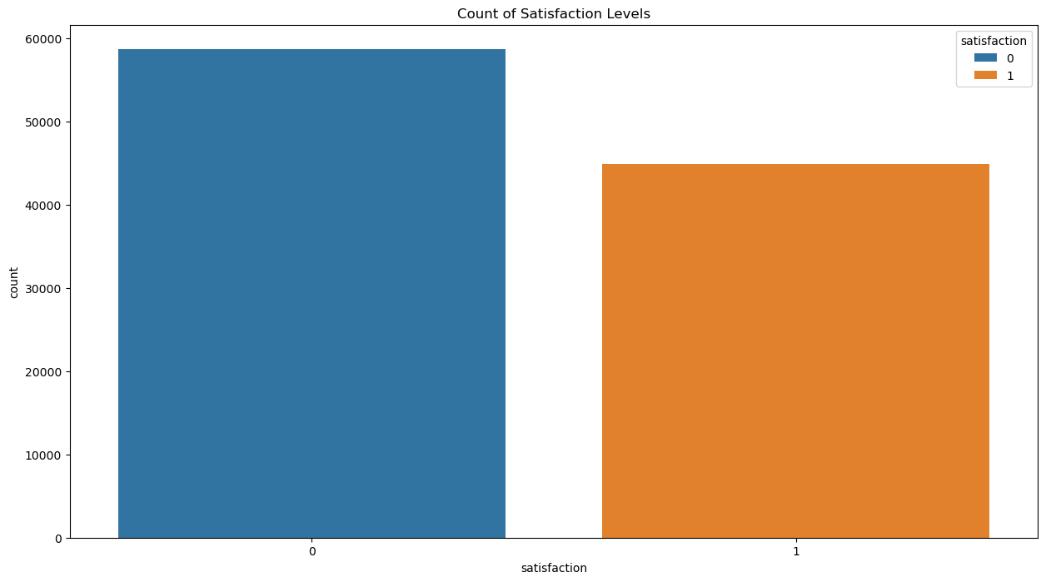
Distribution Analysis

Slide 8
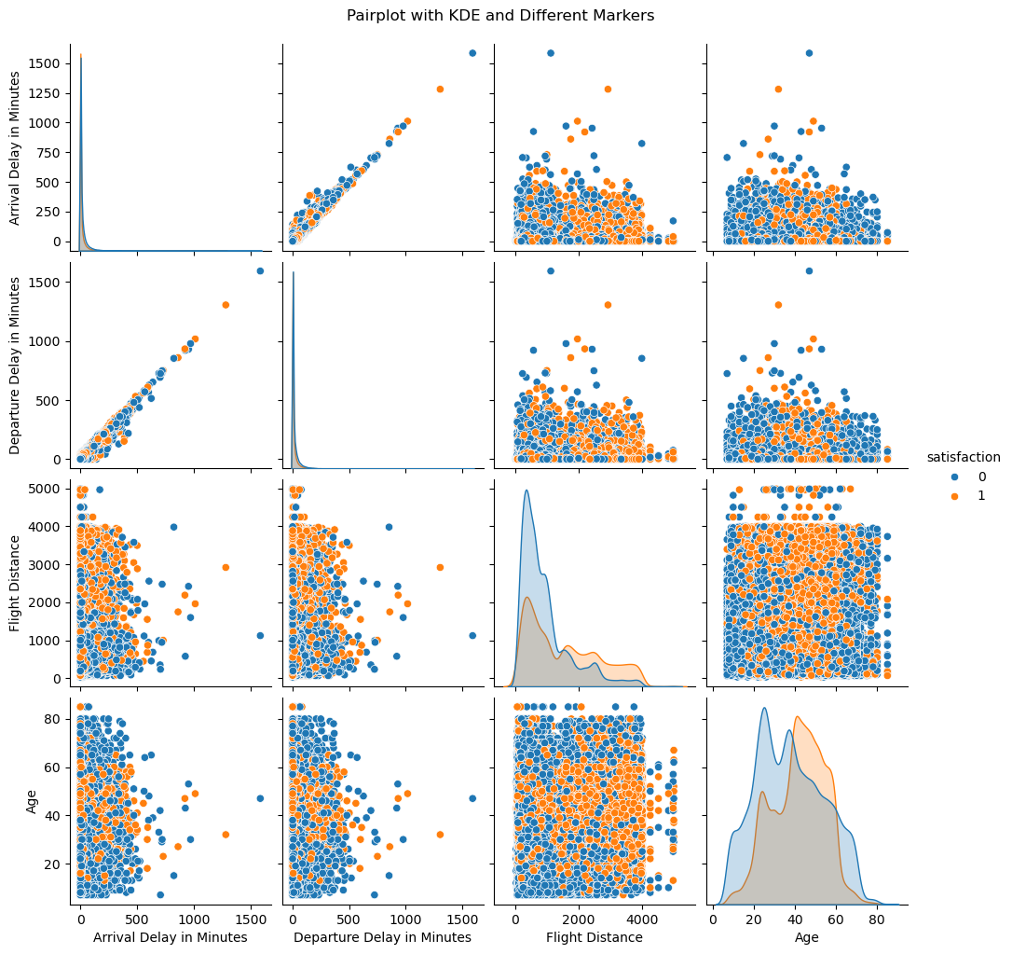
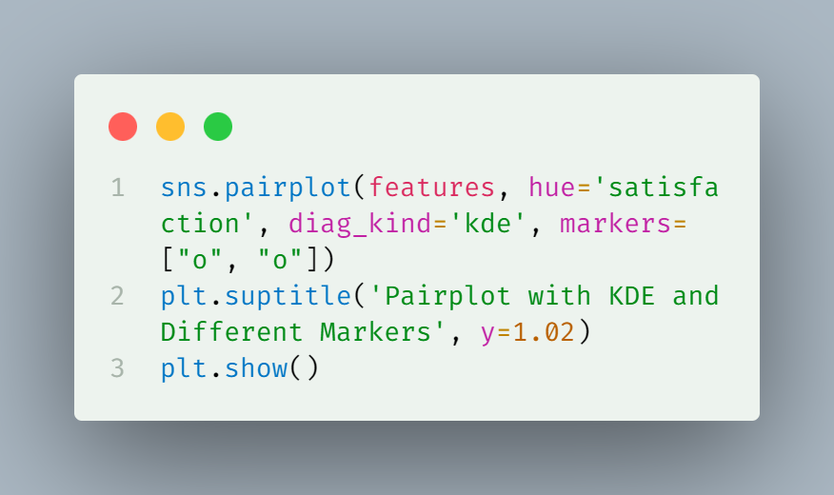
Distribution Analysis
Pair Plot Analysis

Slide 9
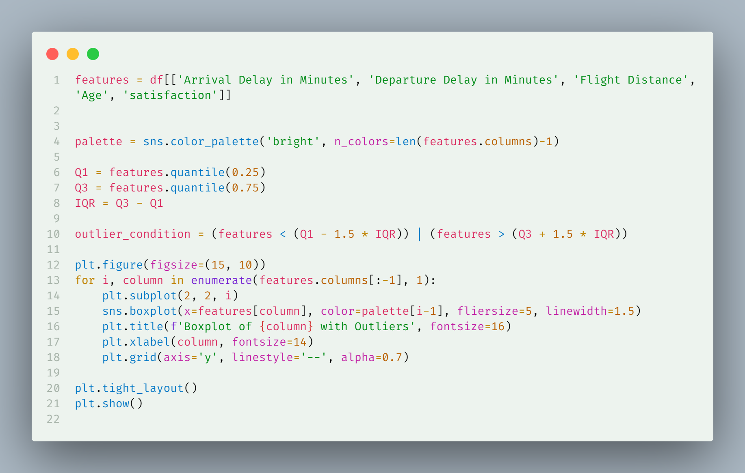
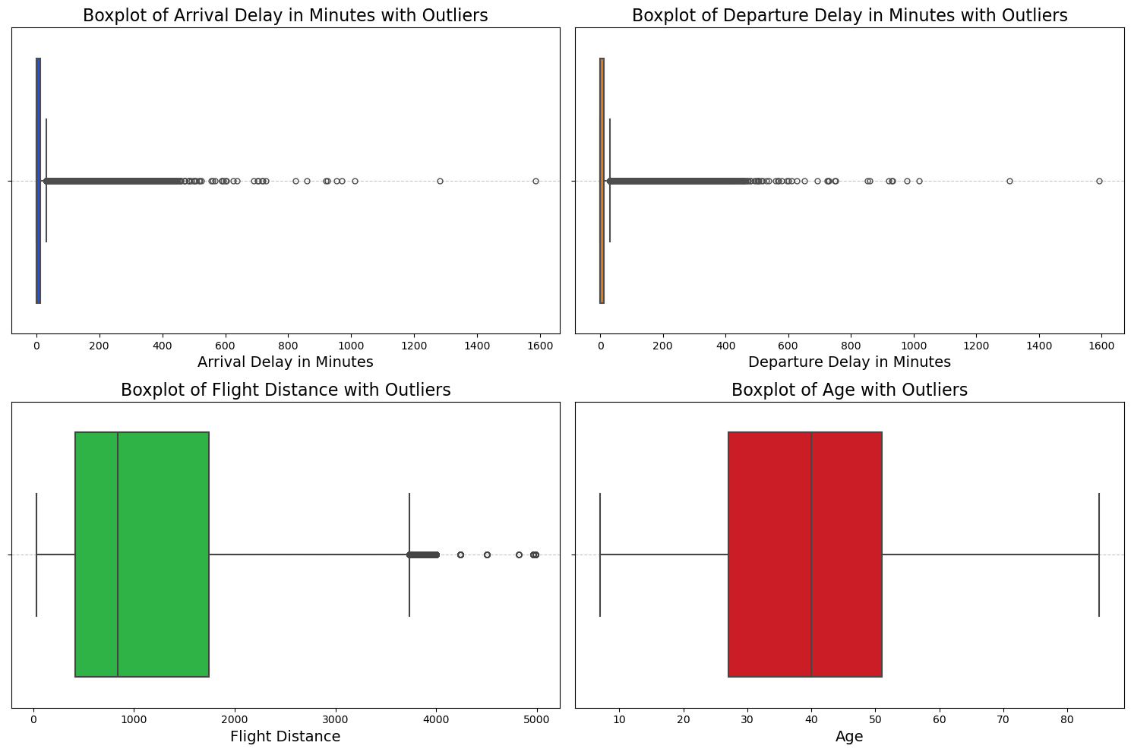
Distribution Analysis
Box Plot Analysis for Outlier Detection

Slide 10
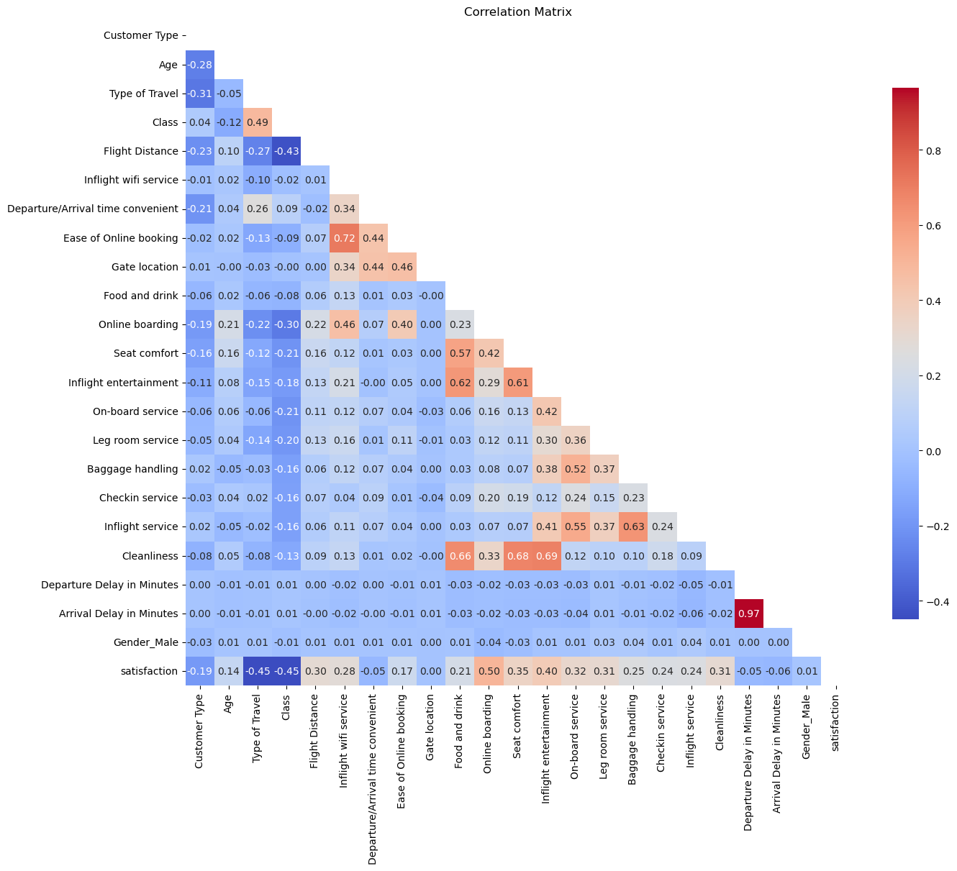
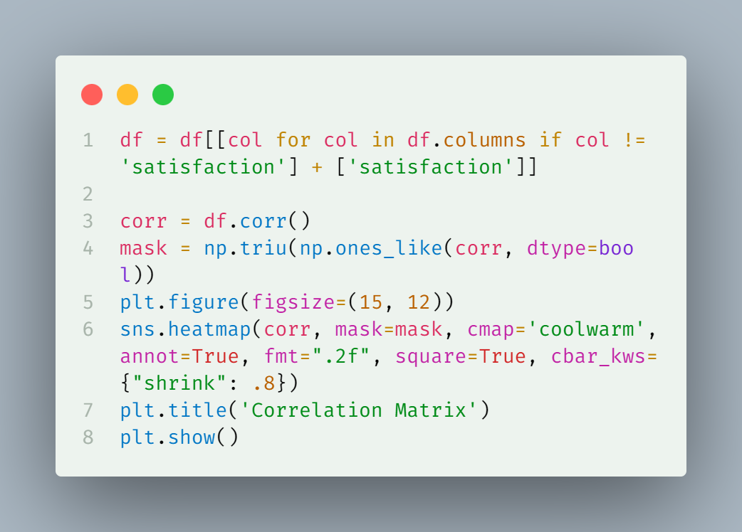
Correlation Analysis

Slide 11
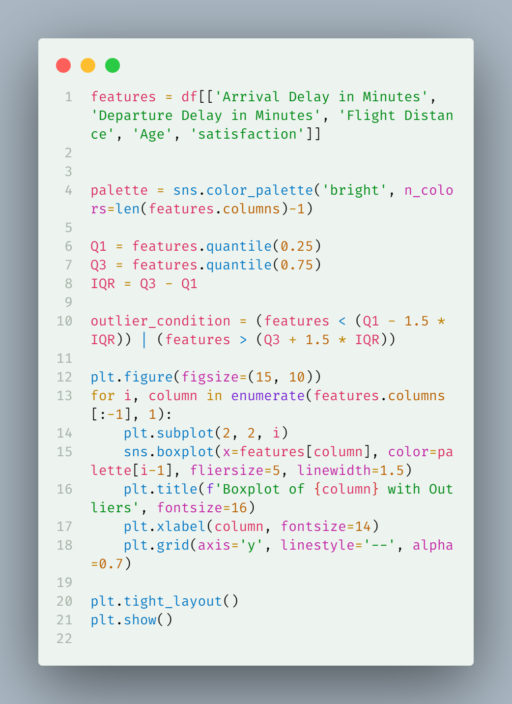
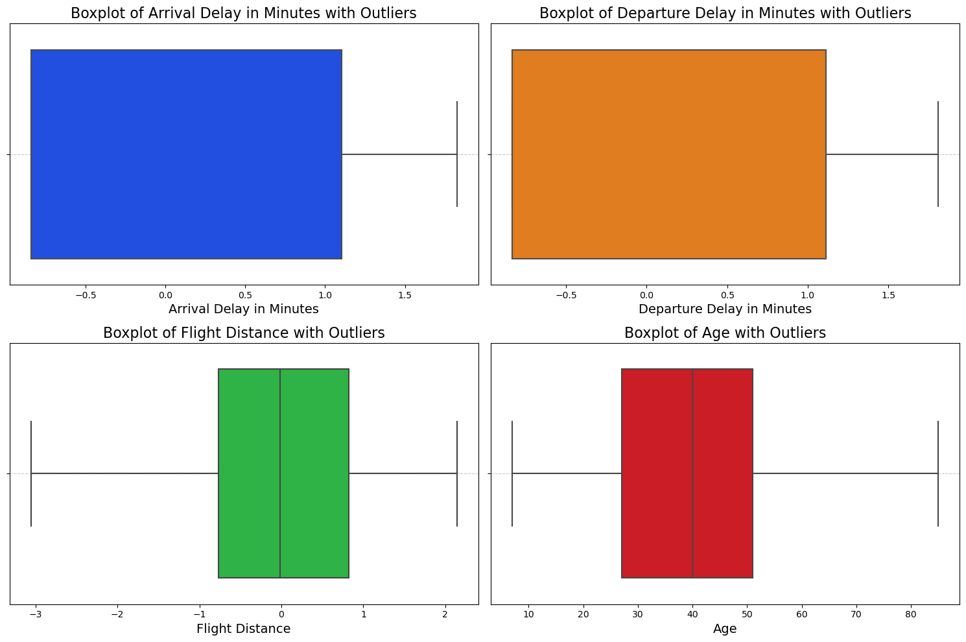
Feature Engineering
Yeo-Johnson Transformation for outlier handling

Slide 12
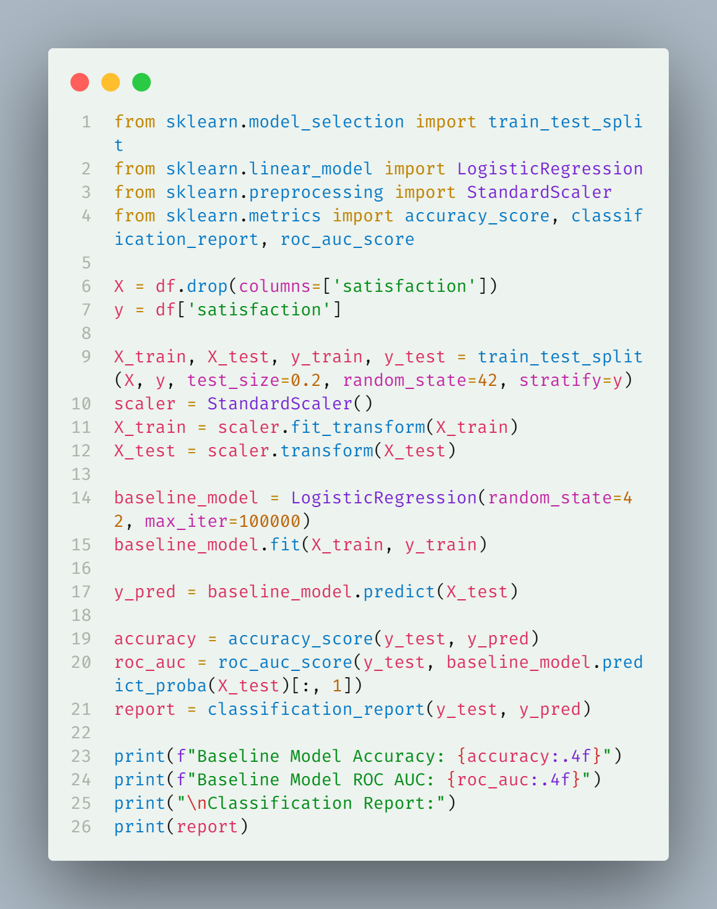
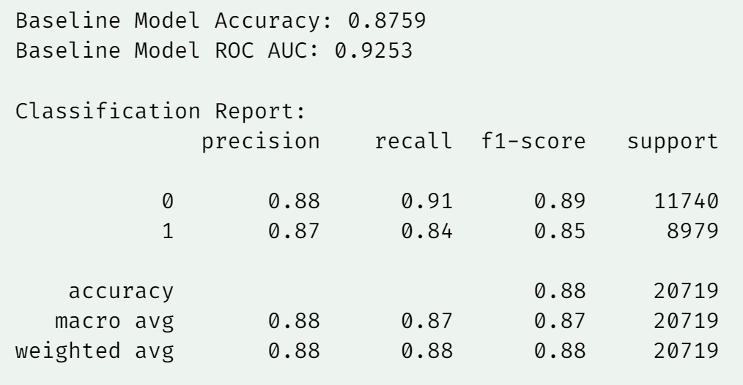
Model Training
Baseline Model Performance

Slide 13
Model Comparison
Model | Accuracy | ROC AUC | R2 Score
CatBoost | 0.965346 | 0.963122 | 0.858877
XGBoost | 0.963801 | 0.961667 | 0.852588
LightGBM | 0.963077 | 0.960531 | 0.849639
Logistic Regression | 0.8759 | 0.9253 | 0.772895

Slide 14
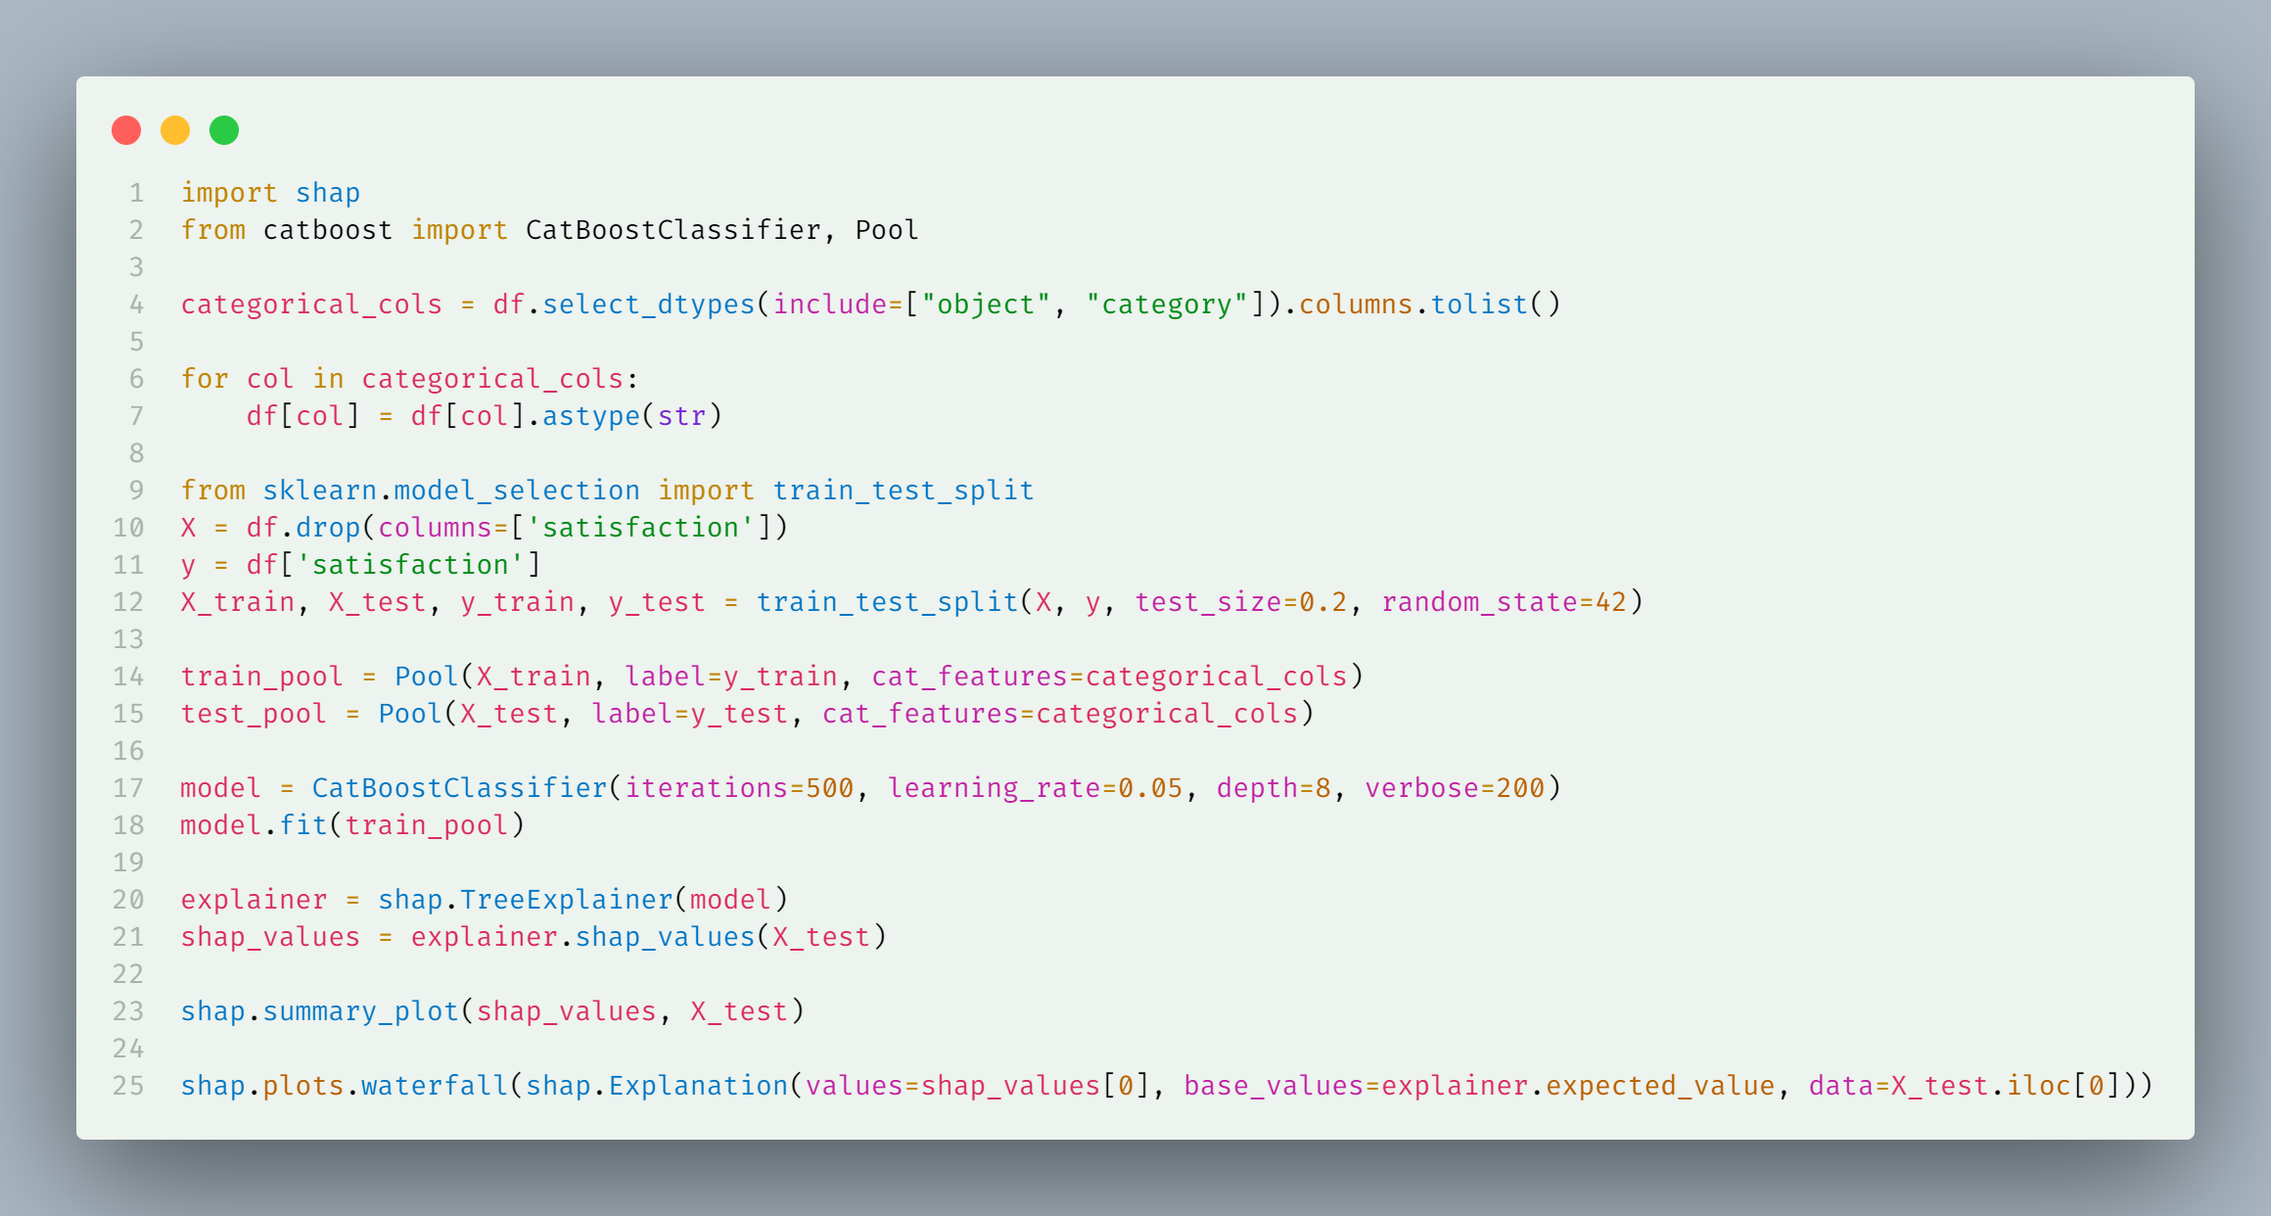
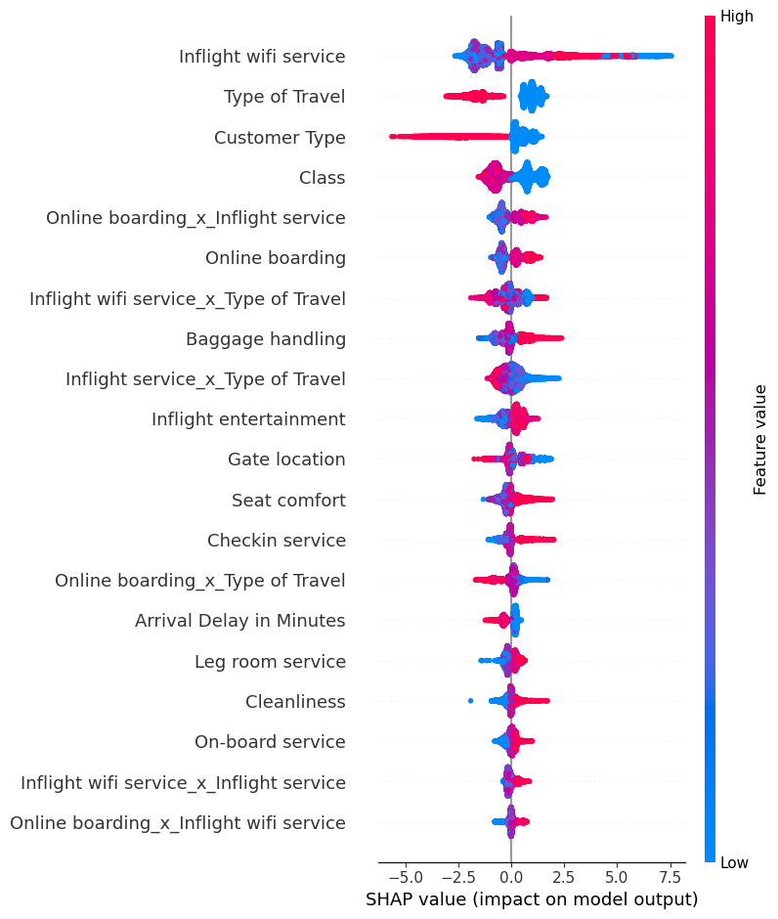
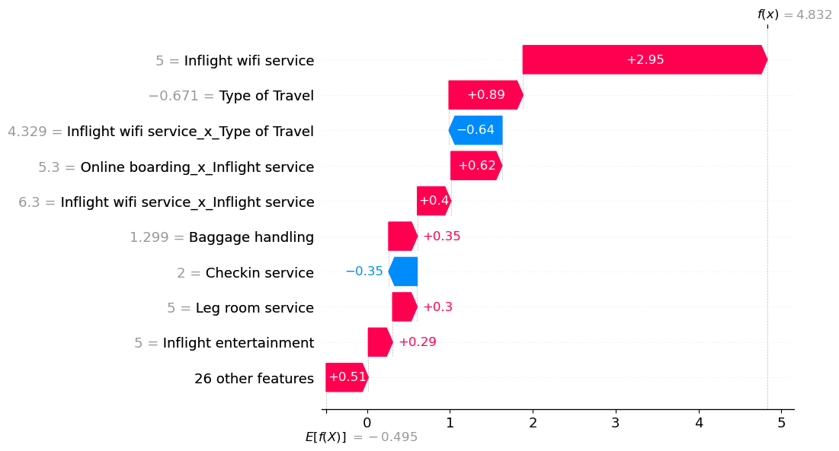
SHAP Explanation

Slide 15
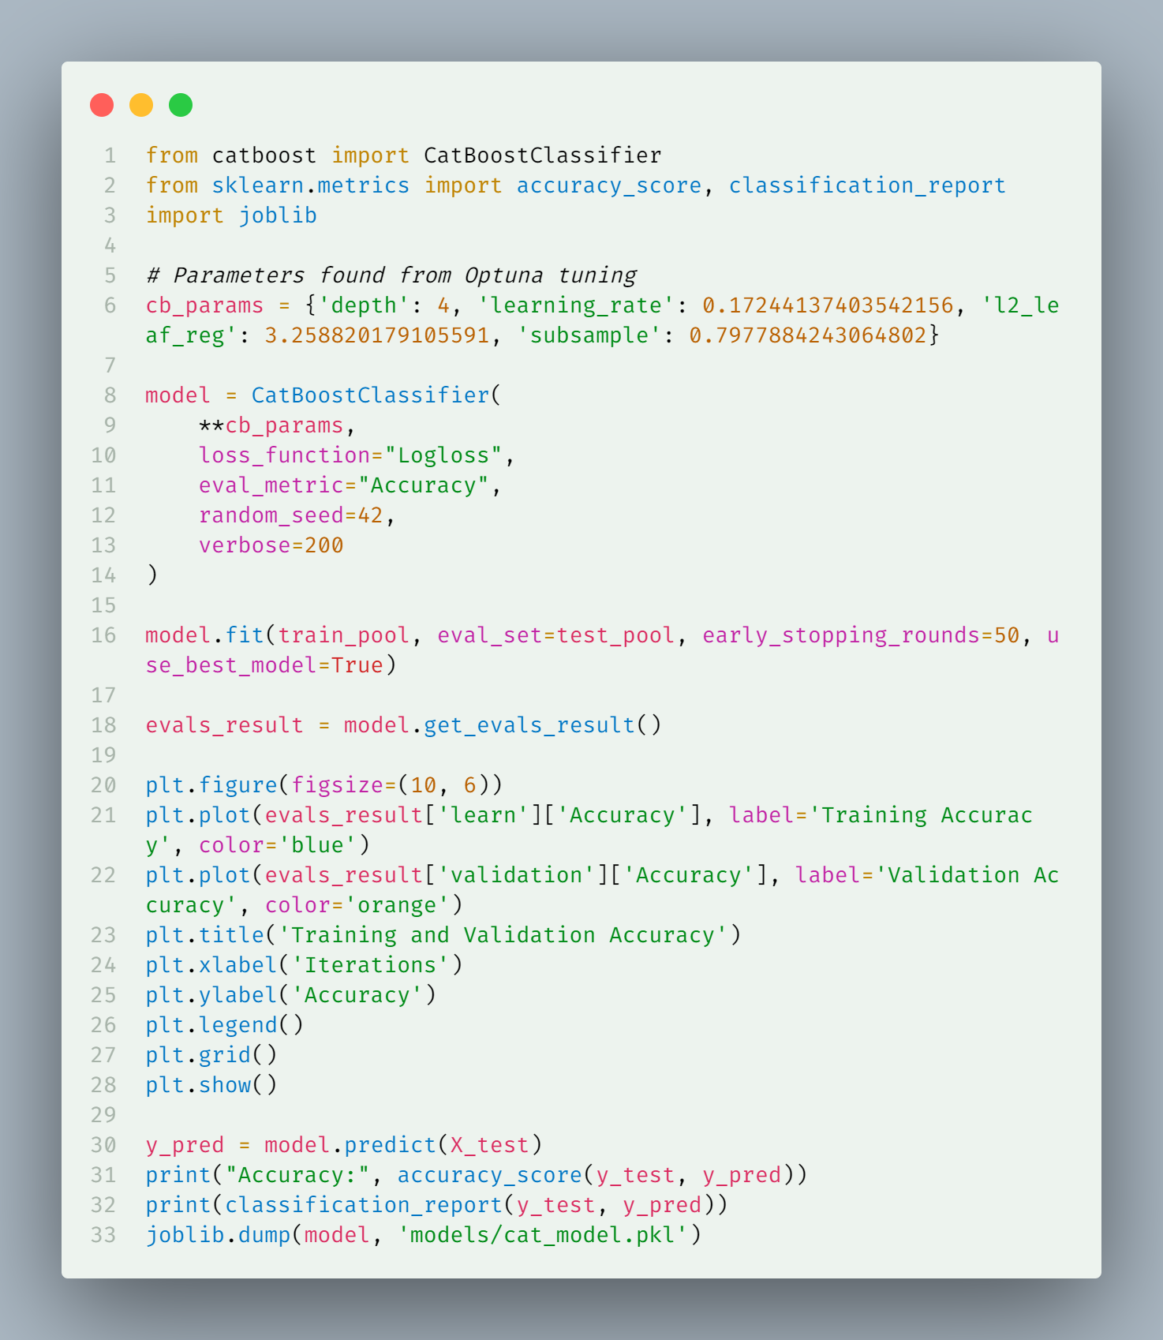
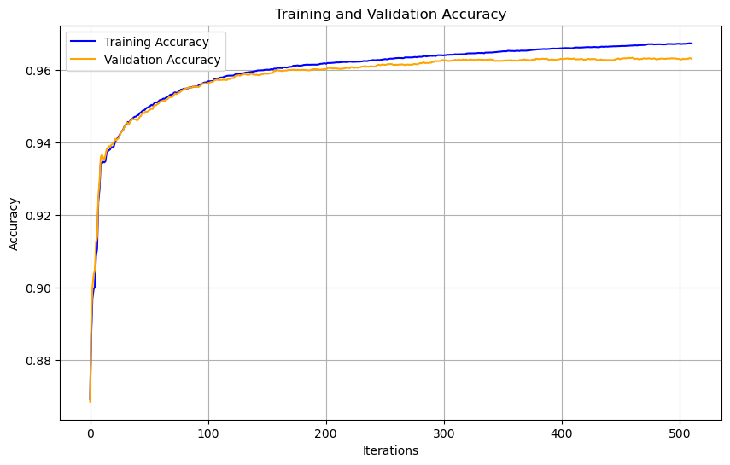
Train & Validation Accuracy
After optimising using Optuna

Slide 16
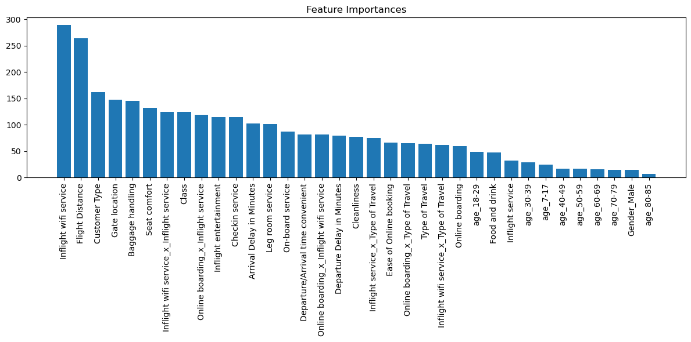
Feature Importance

Slide 17
Key Insights

Slide 18
Most Influential Features
Inflight wifi service: Highest overall impact
Type of Travel: Significant variability in satisfaction
Customer Type: Strong influence on rating
Impact Dynamics
Positive Influences:
Class
Online boarding
Inflight entertainment
Negative Influences:
Arrival Delay (consistently reduces satisfaction)
Inconsistent wifi service

Slide 19
Recommendations
Prioritize Wifi Quality
Consistent, high-speed internet
Uniform service across different travel types
Minimize Arrival Delays
Improve scheduling
Enhance operational efficiency
Personalized Customer Experience
Tailor services to different customer types
Segment-specific satisfaction strategies
Continuous Improvement
Monitor and enhance secondary features
Holistic approach to service quality

Slide 20
Md. Rafiquzzaman Rafi
rafiquzzamanrafi100@gmail.com
Thanks

